Slide 1
Isolated ACTH Deficiency
İzolə olunmuş AKTH çatışmazlığı
Specialty: Pediatrics
Asisstant: NARMİNA ABASLI
Head of Research: ILSUR NOVRUZOV
Azerbaijan Medical University Therapeutical Educational Clinic
Department of Pediatric Allergology Pulmonology Endocrinology
Baku 2022

Slide 2
Case History
8 month old boy was referred to the pediatric service with the following complaints:
Hypotonia
Weakness
Eye gazing
Seizures
Incident of shaking 40-50 times a day

Slide 3
Previous History
Only Child
Consanguineous Parents
From first birth, second pregnancy (first pregnancy: miscarriage in the second month of pregnancy due to CMV)
Born at 41 weeks ( maternal history: BP:220/160)
Cesarean delivery
Weight 3,500 gr
Height 51 cm

Slide 4
History of Present Illness
1st day
3rd month
Vomiting
Jaundice
Hospitalization due to: Jaundice
Phototherapy was effective (5 days)
Admission to hospital: respiratory tract infection
(7 day)
TSB 9,17mg/dL (0,4-1,2)
AST 403 U/L (9-80)
ALT 128 U/L (10-90)
Cholestasis
3-6 month
6th month
Prolonged jaundice
Treatment with: Phenobarbital
Ursodesoxycholic acid
TSB 5,08 mg/dL (0,4-1,2)
ALT 269 U/L (10-90)
AST 327 U/L (9-80)
GGT 107 U/L (12-64)
Admission to IUC:with bilateral pneumonia
Short-term seizures (Phenobarbital)
Disappearing developmental stage
TSB 1,1 mg/dL (0,4-1,2)
ALT 98 U/L (10-90
AST 80 U/L (9-80)
GGT 108 U/L (12-64)
Until 6 month he was under control of different doctors, and developmental steps appropriated with age

Slide 5
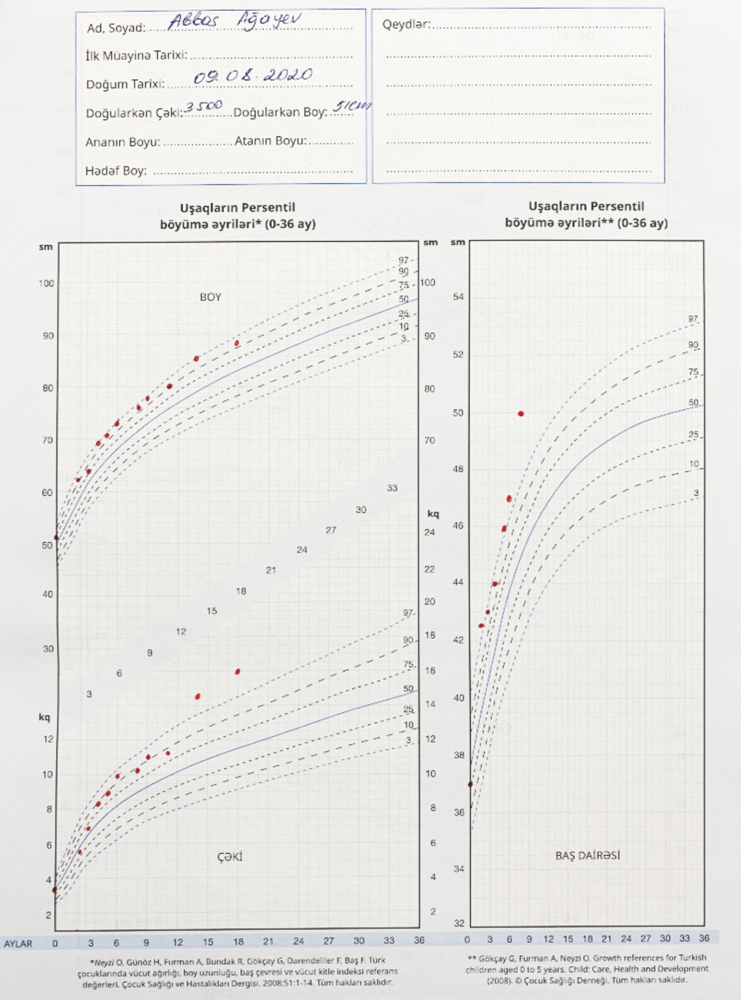
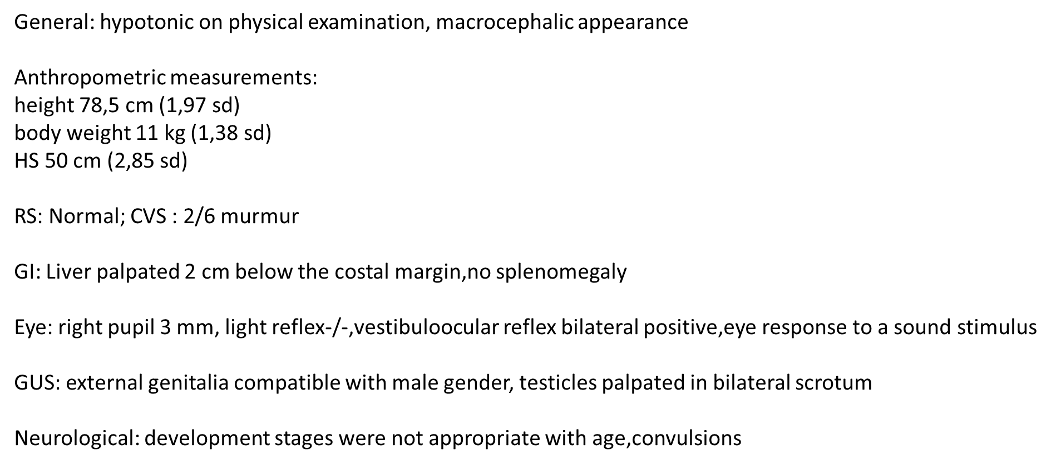
General Examination (8 month)
Indications of fast growth

Slide 6
Investigations (8 month)
Existing ophthalmologic pathology is congenital and not related to metabolic disease.
No visual Impairment
Optic nerve was normal
Eye examination: no light reflex in the right eye, weak light reactions, parafoveal Torpedo maculopathy, enlarged pupils, fundus right-left optic disc hypoplastic?
Abdominal USM: Fatty liver
metabolic
neurological
What were our suspects?
EEG-basal activity was weak, small seizure patterns were detected
He had hypoglycemia once during follow up (22mg/dL)
endocrinological
WES was performed

Slide 7
Investigations (9 month)
Metabolic Screening
Amino acid analysis | Negative
Urine amino acid | Negative
Organic acid profile in urine | Negative
Laboratory Results
TSH miu/mL | 7,35 | (1,36-8,8)
FT3 pmol/L | 6,71 | (3,1-6,8)
FT4 pmol/L | 11,11 | (6,2-30,1)
Insulin mu/mL | 0,767 | (2,6-24,9)
C-peptide ng/mL | 0,344 | (1,1-4,4)
Pth pg /mL | 17,96 | (12-65)
Prolactin pmol /L | 440,5 | (69-483)
Cortisol nmol/L | <1,50 | 171-536
ACTH pg/mL | <1,00 | 7,2-63,3
TB μmol/L | 4,45 | (3-23)
DB μmol/L | 0,45 | (0-5,2)
IDB μmol/L | 4 | (3-17,8)
ALT U/L | 62 | (13-45)
AST U/L | 57 | (15-60)
GGT U/L | 26 | (1-39)
Glucose nmol/mL | 3,8 | (3,3-5,6)
Ca nmol/l | 1,35 | (1,16-1,51)
IGF-1 ng/mL | 34,58 | 11,8-94,6
HGH ng/mL | 2,56 | 0,094-6,29
MRI: Pituitary imaging was normal

Slide 8
WHAT IS A DIAGNOSIS?
Recurrent Respiratory infections
Cholestasis
Seizures
ACTH deficiency
Jaundice
Hypoglycemia
Notes:
Speaker David

Slide 9
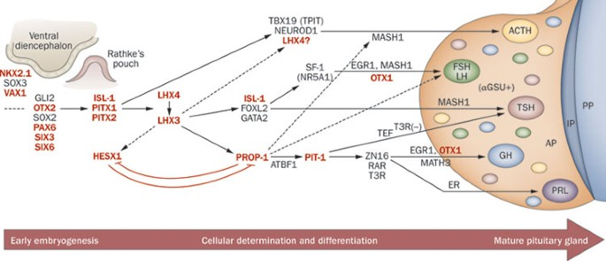
Conclusion
The c.302 G>A variant detected as homozygous in the TBX19 gene causes the Tryptophan amino acid at position 101 to be converted to the STOP codon. According to HGMD database, its defined as disease causing with access code CN191672.Its classified as pathogenic according to ACMG criteria
TBX19 is required for transcription processing of the POMC gene,which produces the precursor peptide from which ACTH is derived.

Slide 10
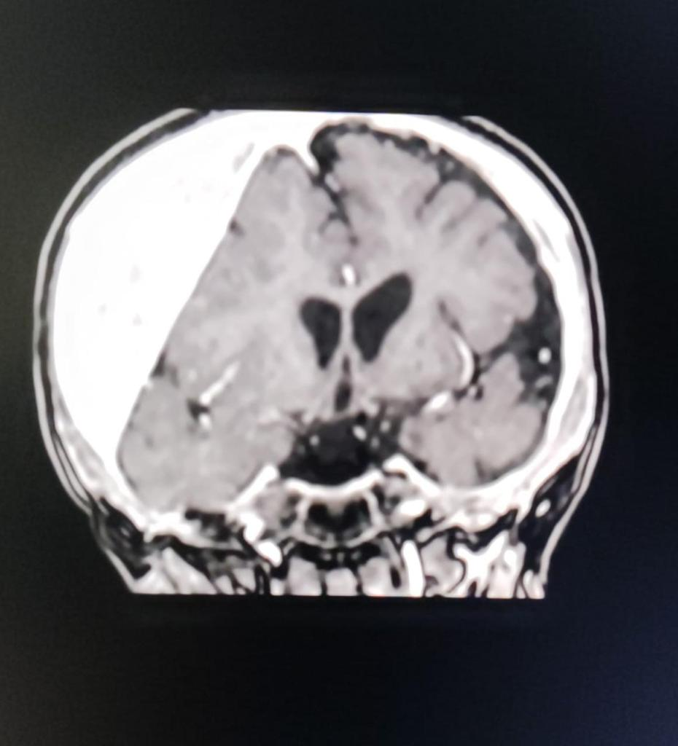
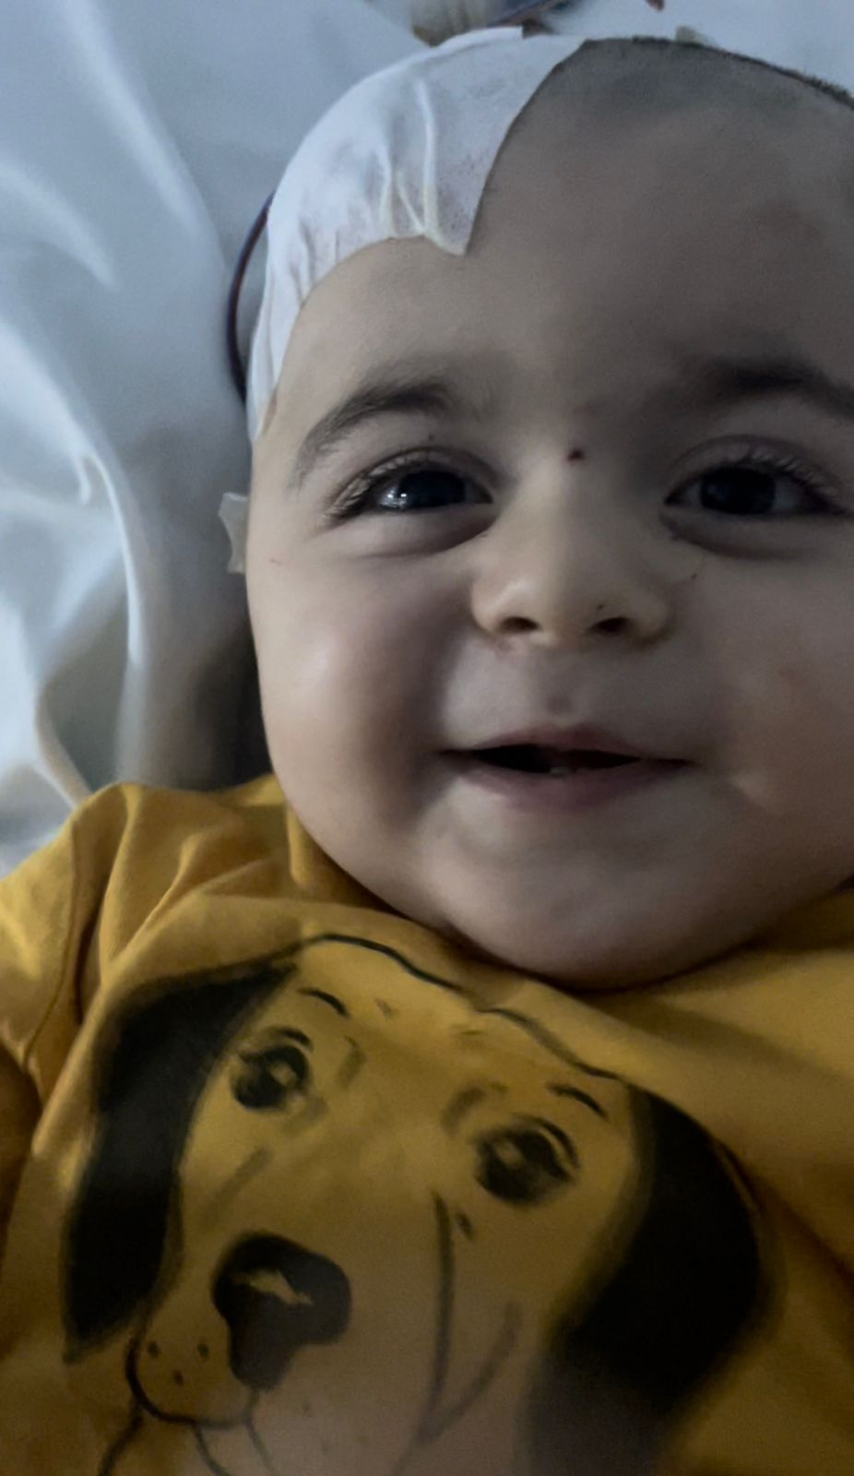
Follow-up
Hydrocortisone treatment was started (15 mg/m2/day) (9 month)
Treatment was effective. His convulsions decreased but not totally passed.(12 month) (12mg/m2/day)
At his last examination: decreased all motor reflexes, seizures increased again (18 month)
Subdural Hematoma:30 mm (at 15 month child fell and hit his head)
Is there any interaction between isolated adrenal insufficiency and child’s neurological status?
MRI
Subdural Paracentesis + Finlepsin+ HC (12mg/m2/day)
He hadn’t has seizure since surgery

Slide 11
Secondary Adrenal Insufficiency Causes
ACTH suppression
Chronic infection
Chronic stress
GC suppression
2) Congenital Multiple Pituitary Hormon Deficiency:
Genetic: HESX1,OTX2,LHX4, PROP1 ,SOX3
Idiopathic
3) Isolated ACTH Deficiency:
Genetic (e.g. TBX19 gene mutations)
POMC deficiency
Prohormone convertase 1 deficiency
4) Acquired multiple pituitary hormone deficiency

Slide 12
Thank You

